Slide 1
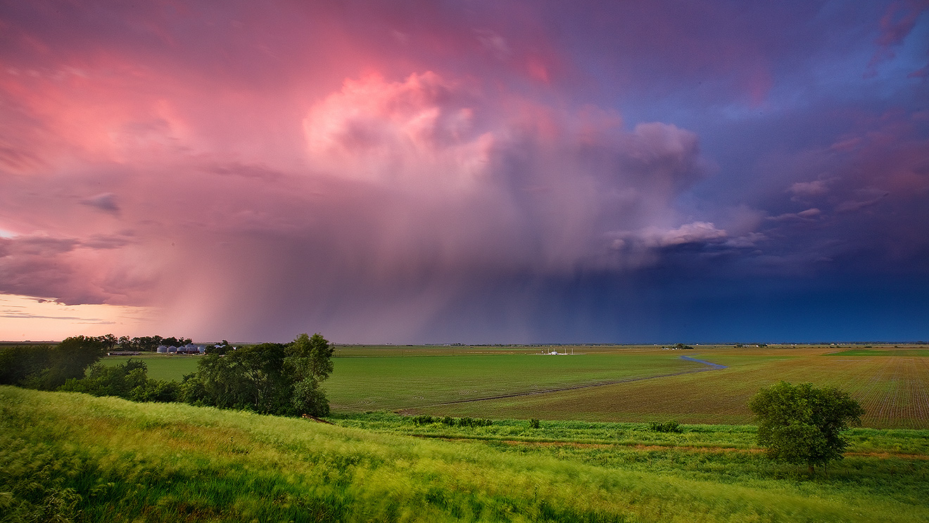
Quaternary Geology of the Omaha, NE area
Dr. Jon Schueth
Assistant Professor of Geology
University of Nebraska Omaha

Slide 2
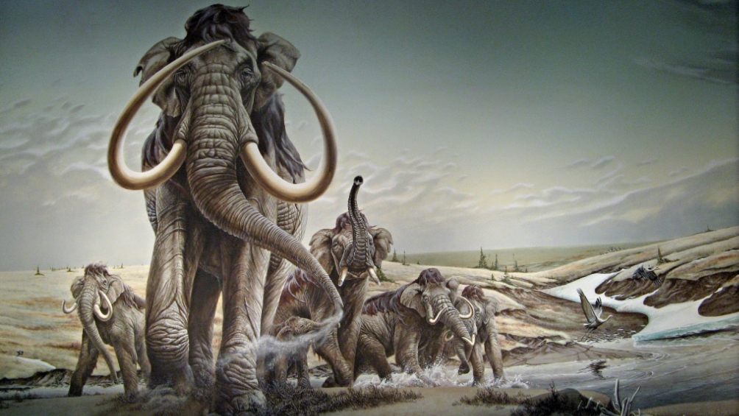
Notes:
Nebraska’s recent geology, in particular the geology that is present at the surface around Omaha, can be defined as shaped by the combined working of glaciers and rivers.

Slide 3
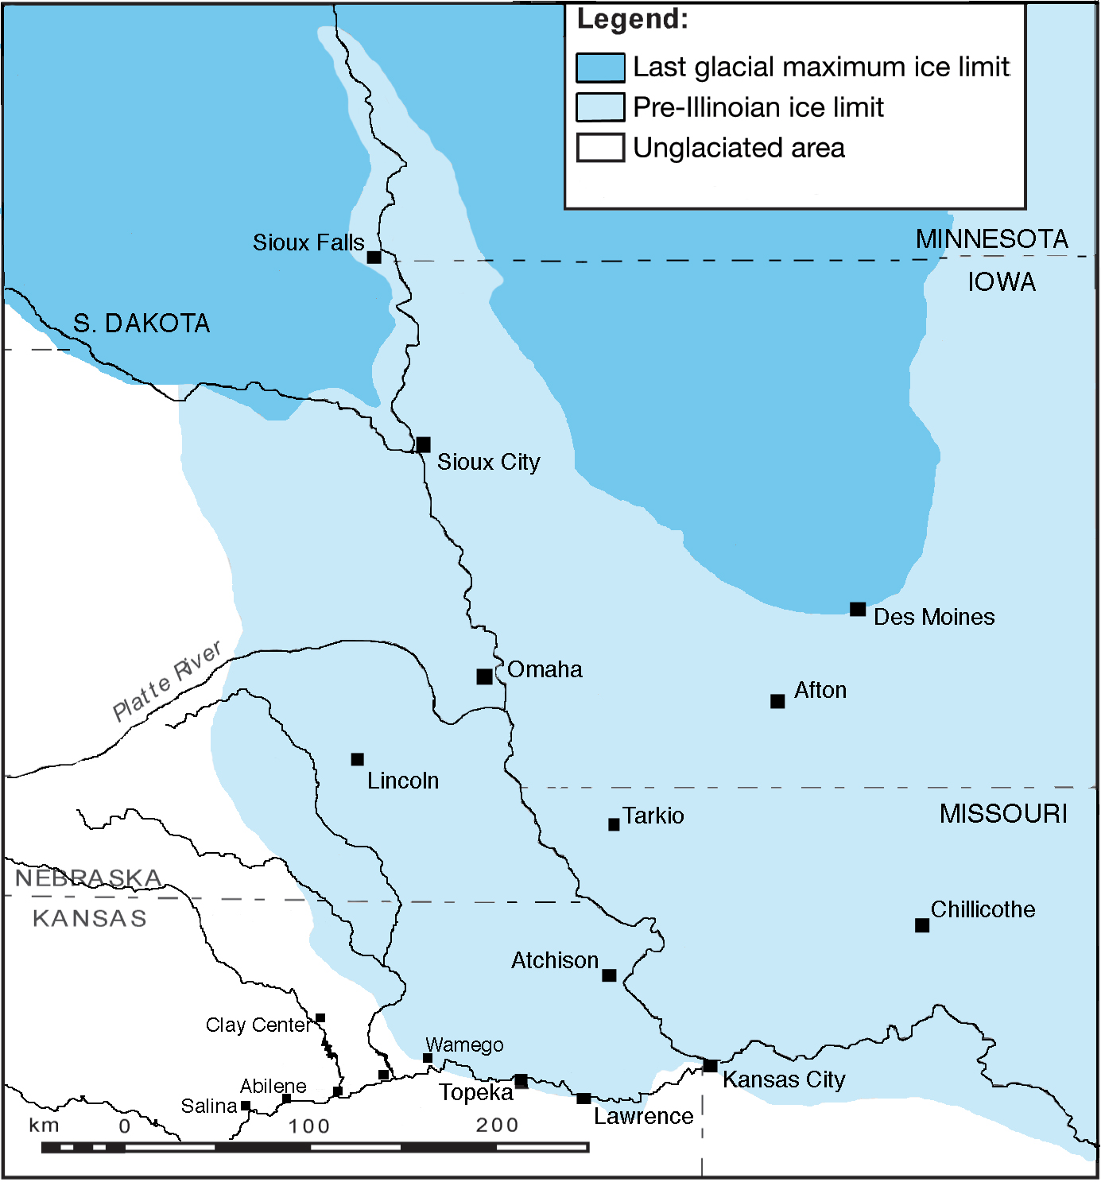
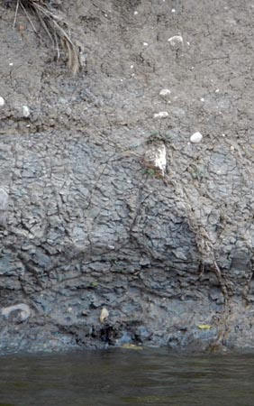
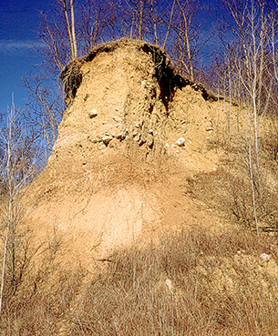
Glacial History of Nebraska
Notes:
Omaha has a mixed glacial history both being covered by ice during the ice overall glacial maximum and near ice during the last glacial maximum. There are two main glacial sediments in the Omaha area that define the landscapes and surficial geology: till and loess

Slide 4
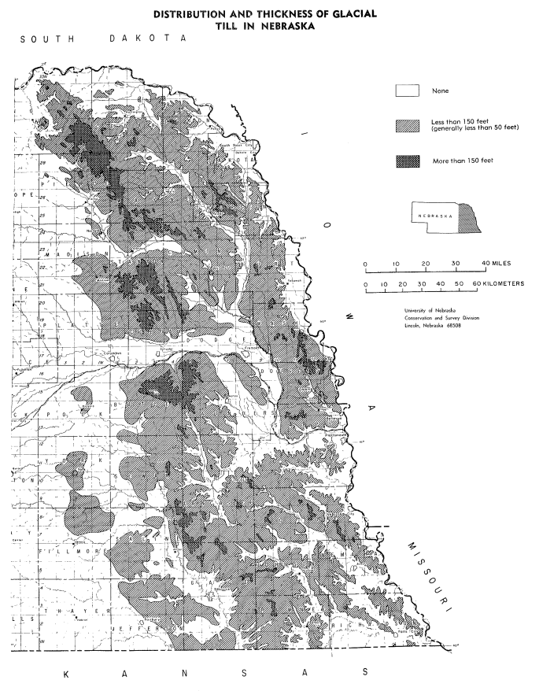
Omaha
Notes:
Till is generally distributed across eastern NE with thickness generally defined by the level of dissection from modern fluvial systems.

Slide 5
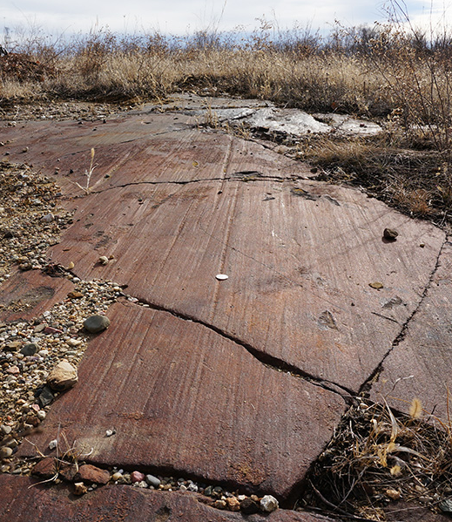
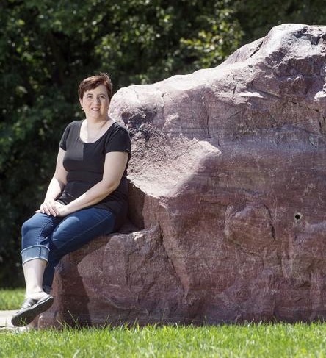
Evidence of Glaciation
Notes:
Outside of glacial till, which mostly is in the subsurface below the soil horizon, a few other important glacial features exist in eastern NE including glacial scours in Omaha and glacial erratics (which are extensive across east Nebraska). The picture on the right shows a large erratic of Sioux Quartzite found near Lincoln, NE

Slide 6
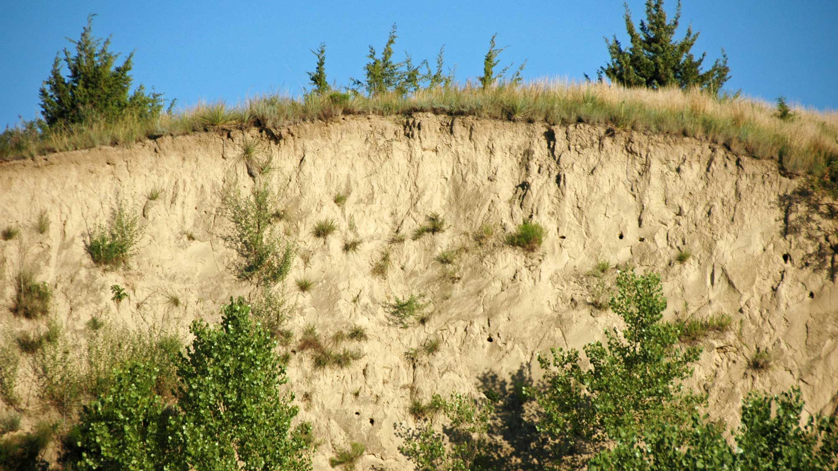
Loess
Notes:
Loess is the most common glacial sediment at the surface around the Omaha area, so let’s look into it a bit more.

Slide 7
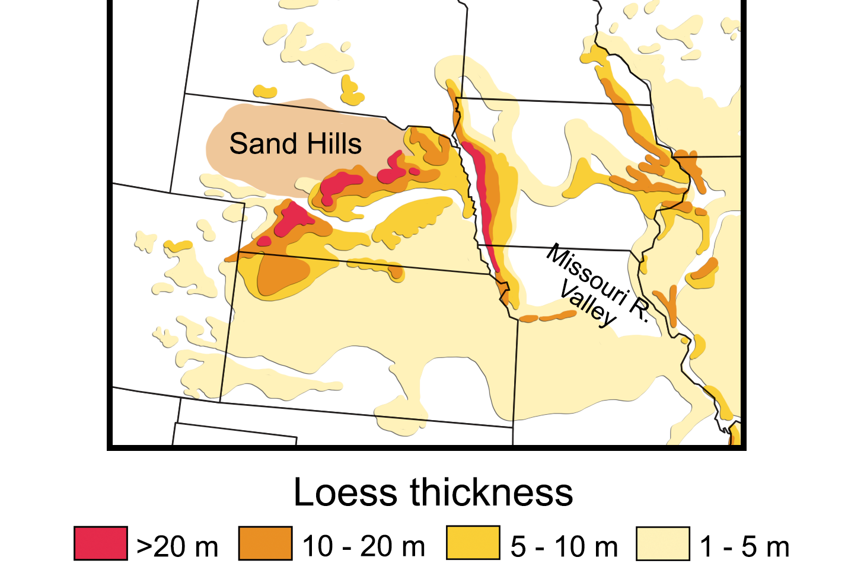
Notes:
Loess blankets most of Nebraska to varying thickness. The losess in the Omaha area is bisected by rivers and streams producing irregular thicknesses and near absence within the Platte and Missouri River valleys.

Slide 8
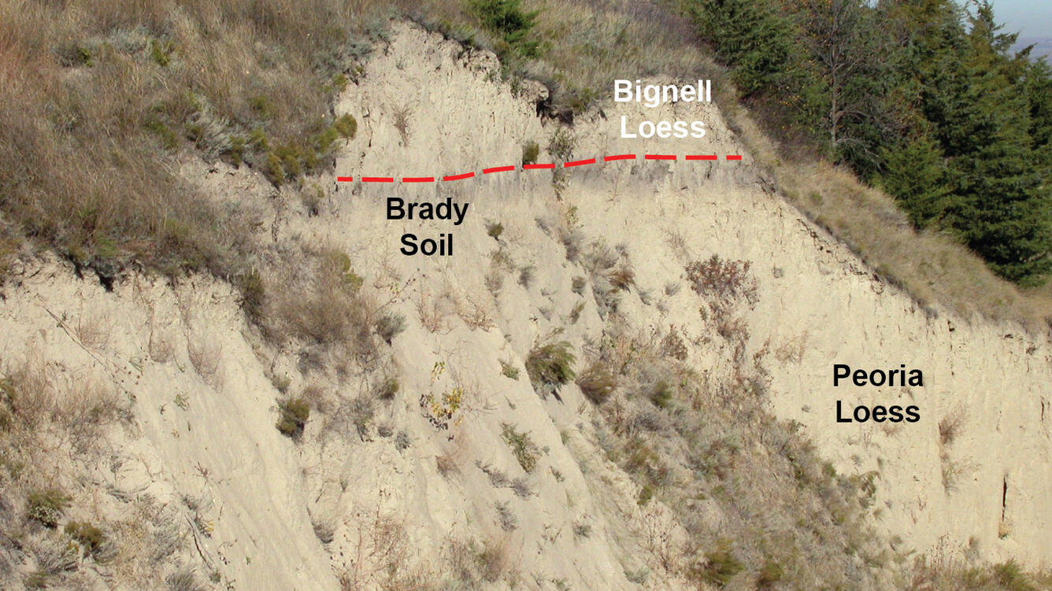
Notes:
The loess has an internal stratigraphy indicating several episodes of deposition separated by soil development. This image shows that stratigraphy with the two primary loess layers being the Peoria and Bignell Loesses. In the Omaha area, the Bignell Loess is not preserved and instead a lower loess layer, the Loveland loess exists

Slide 9
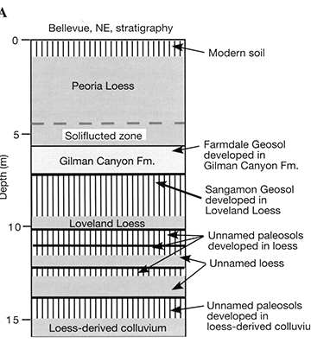
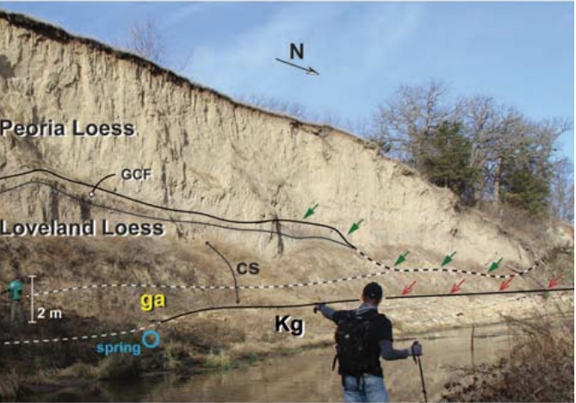
16-20 ka
23-46 ka
165-125 ka
Notes:
The Loess in the Omaha area is better defined with these images which show several loess layers split by lots of missing time and developed paleosols. The Peoria loess also changes in composition through the column being generally clay rich at the base to mostly silt rich at the top (with coarse silt in the middle).

Slide 10
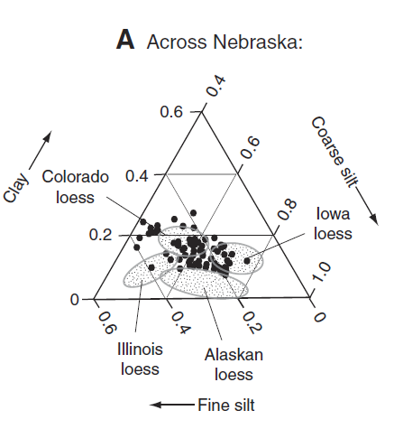
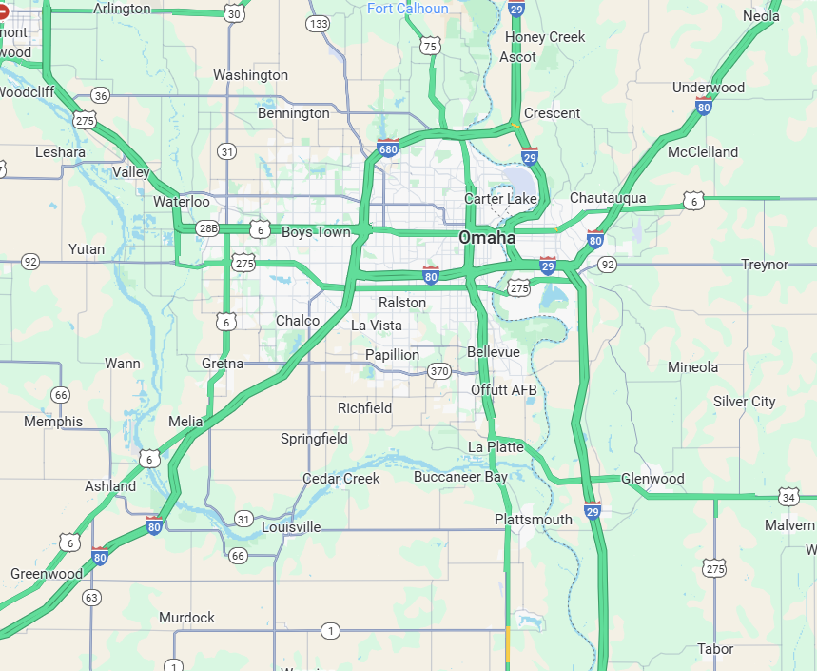
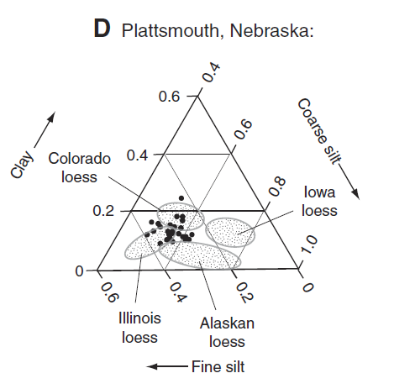
Notes:
Loess in Nebraska is typically made of a mix of clay and course silt depending on location. In the Omaha area, it is more fine silt/clay than in other parts of the state.

Slide 11
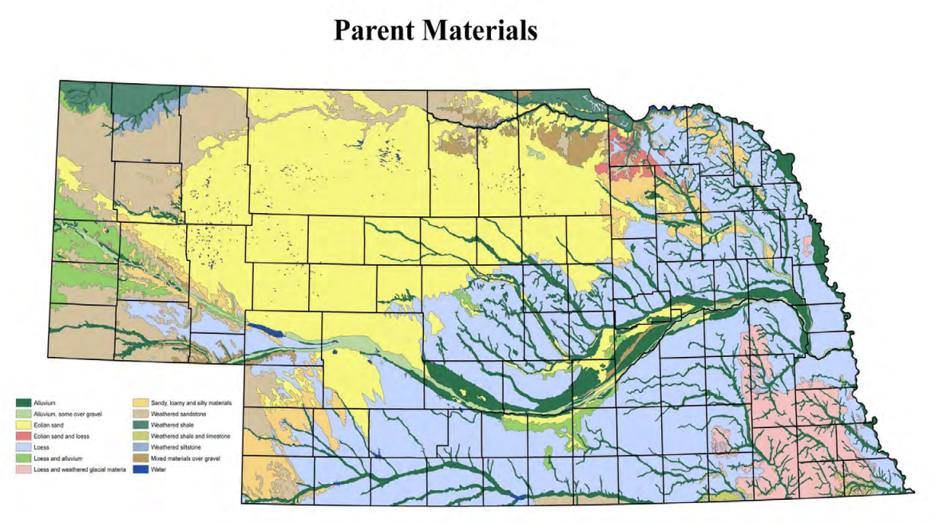
Soil Parent Materials (light blue = loess)
Notes:
Loess has a major role in soil development in the state with most of the soils in the eastern and southern portions of the state having loess as a parent material outside of the fluvial systems that bisect the loess

Slide 12
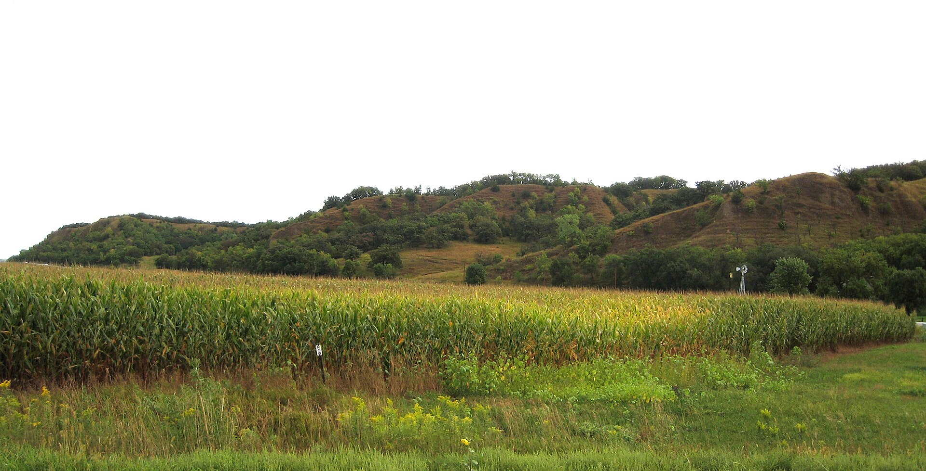
Notes:
The Missouri River has cut through the loess in such a way to develop striking bluffs along the river between Nebraska and Iowa. If you fly into OMA, you can see these across the river.

Slide 13
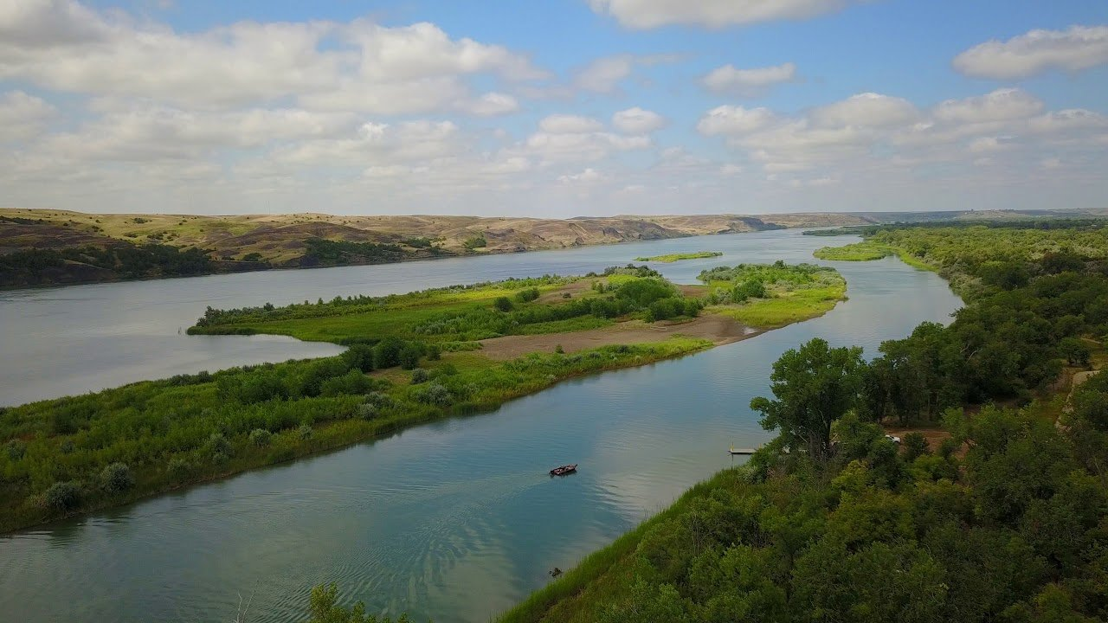
Notes:
The other important control on local surficial geology was already hinted at: Nebraska’s many fluvial systems. Pictured here is the Missouri River

Slide 14
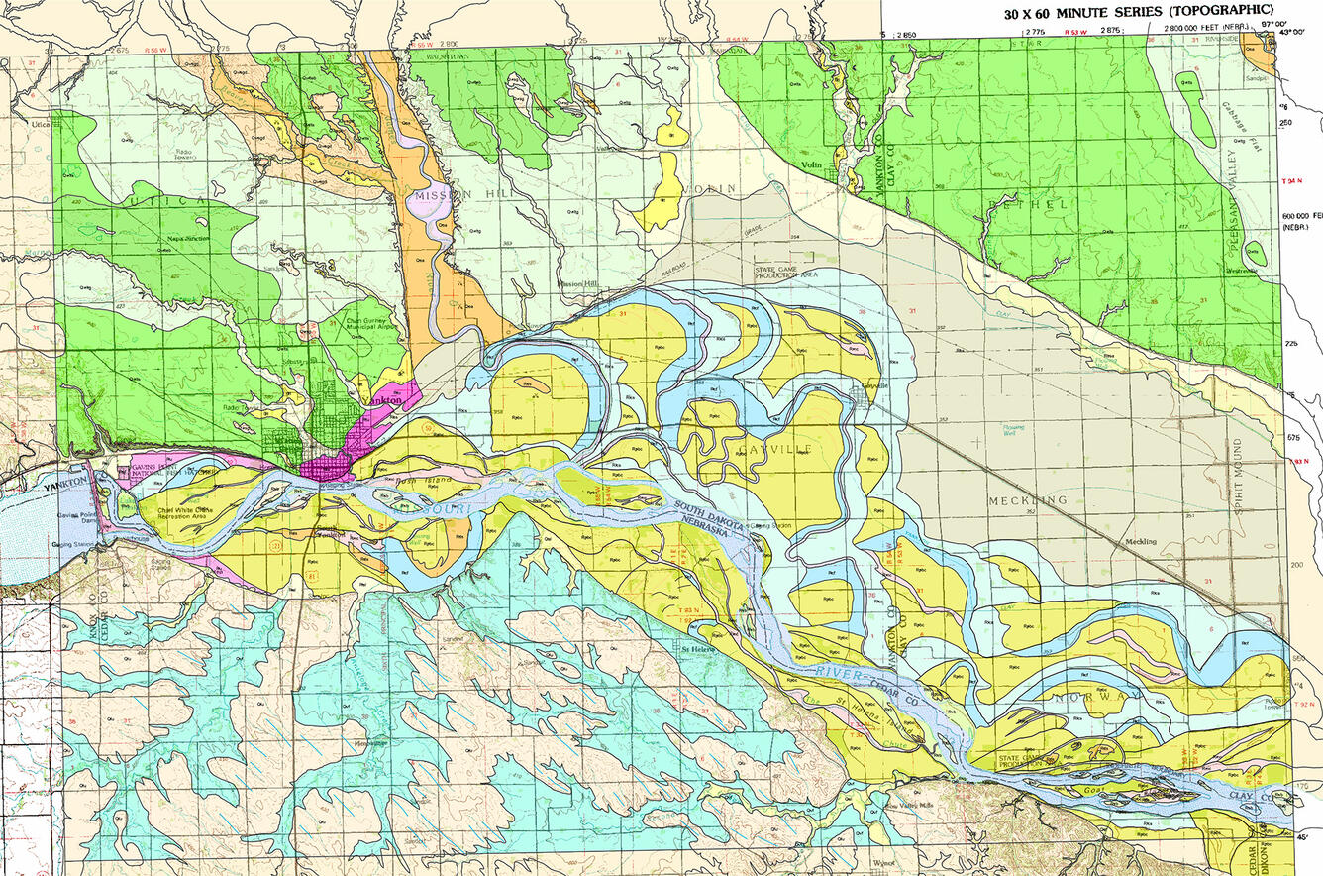
Notes:
The Missouri River is defined by a broad flood plain with several abandoned channels, crevasse splays, and oxbow lakes recording its ever-changing past. The broad floodplain is an important agricultural center for both Nebraska and Iowa where the combination of alluvial aquifer and organic rich soils provide excellent growing conditions.

Slide 15
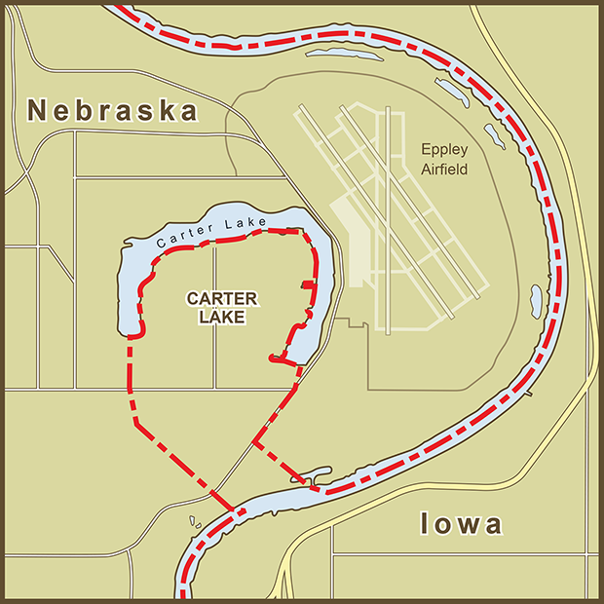
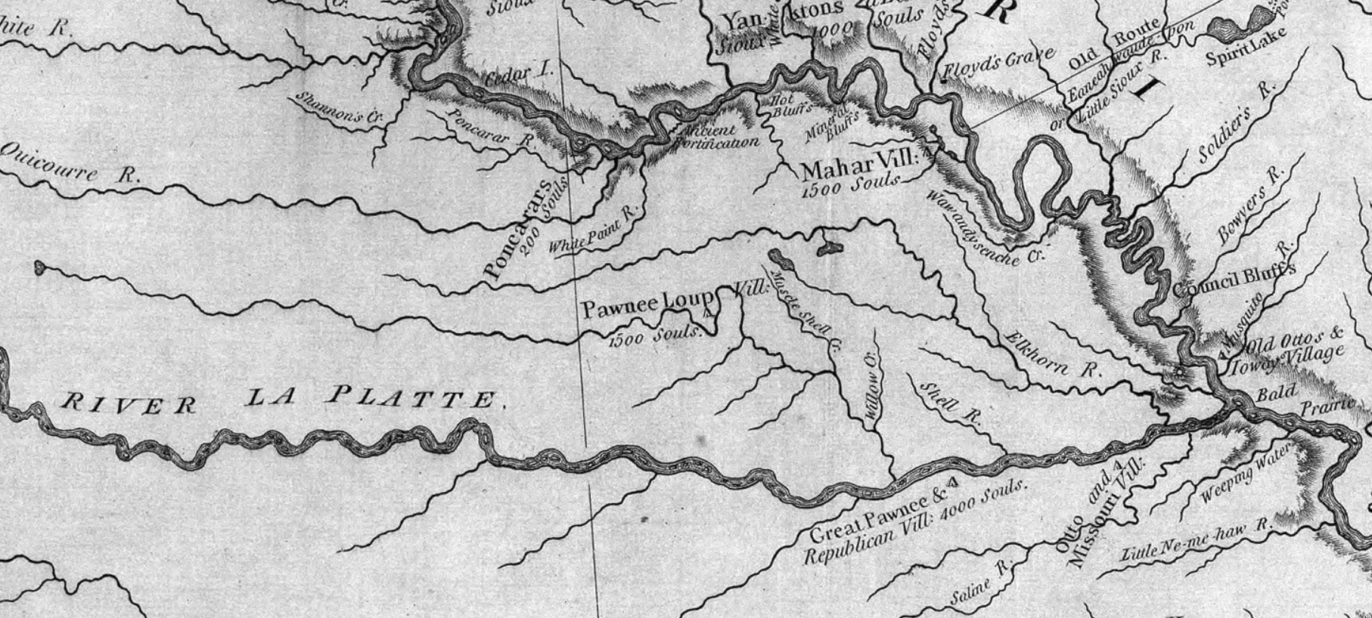
Notes:
This is a map from Lewis and Clarke showing the Missouri river in Nebraska on the right. Before the development of river control measures, the Missouri drastically changed course over the years developing its wide flood plain

Slide 16
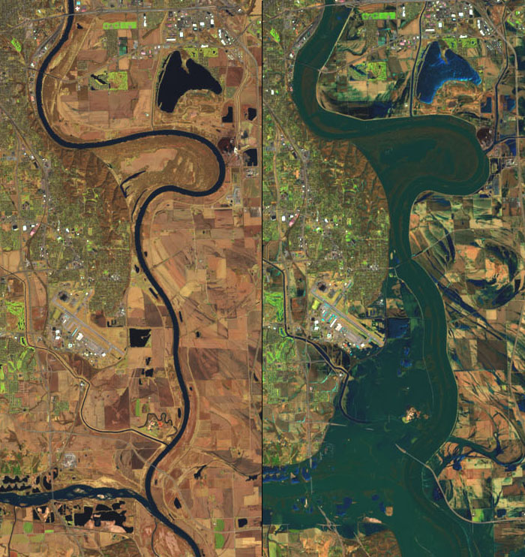
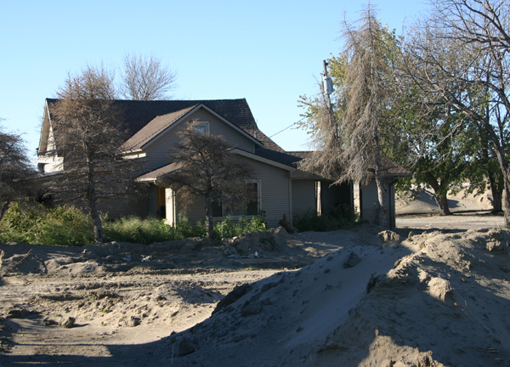
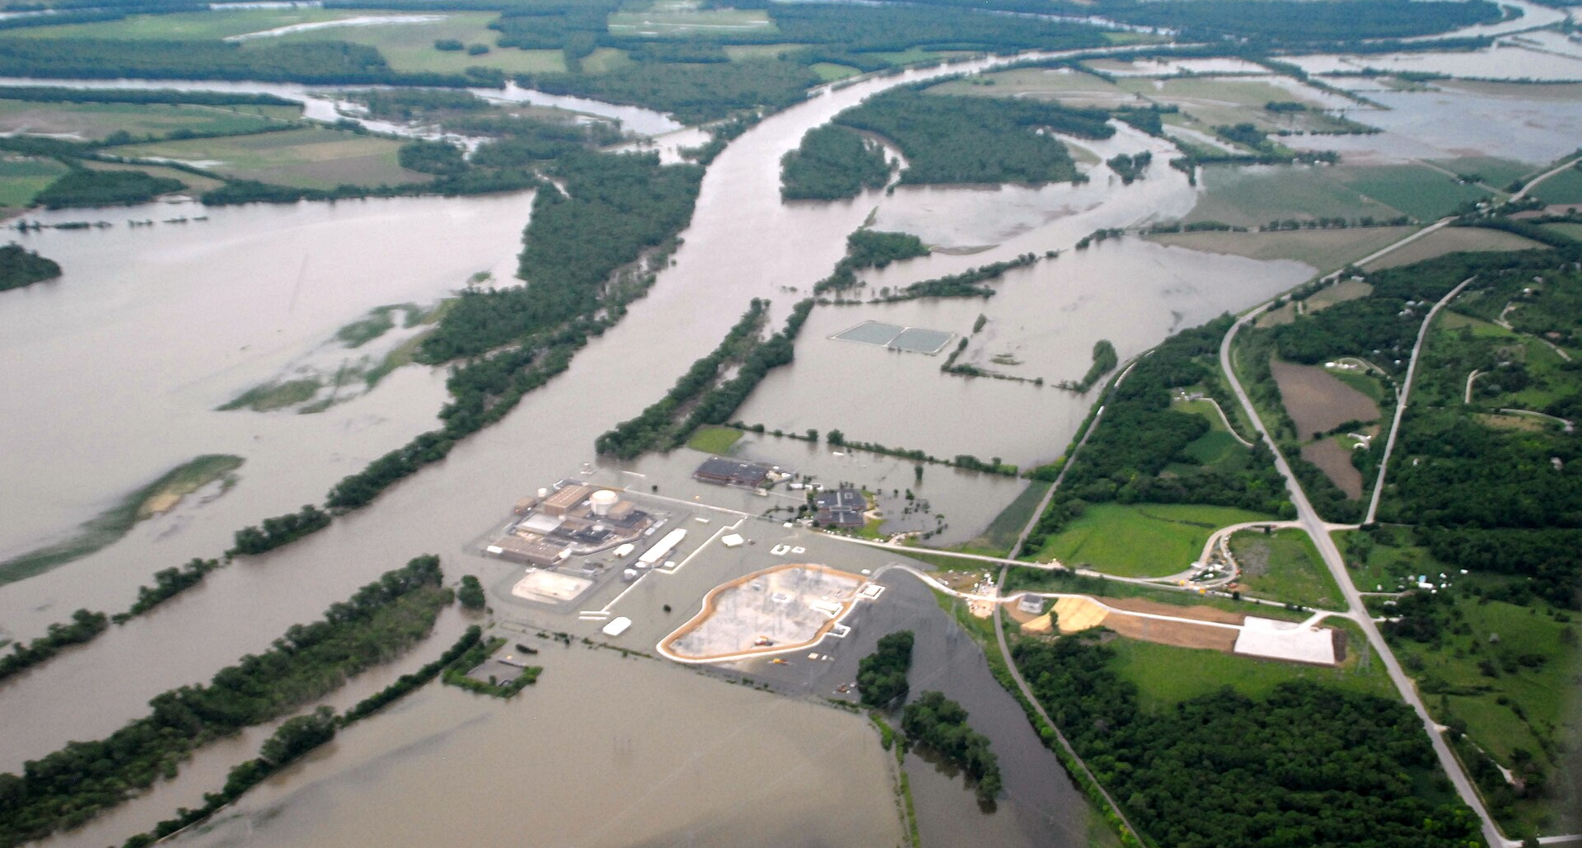
Notes:
Flooding is usual along the Missouri River, especially in the flood plain where floods can deposit thick layers of sand and mud far from the river.

Slide 17
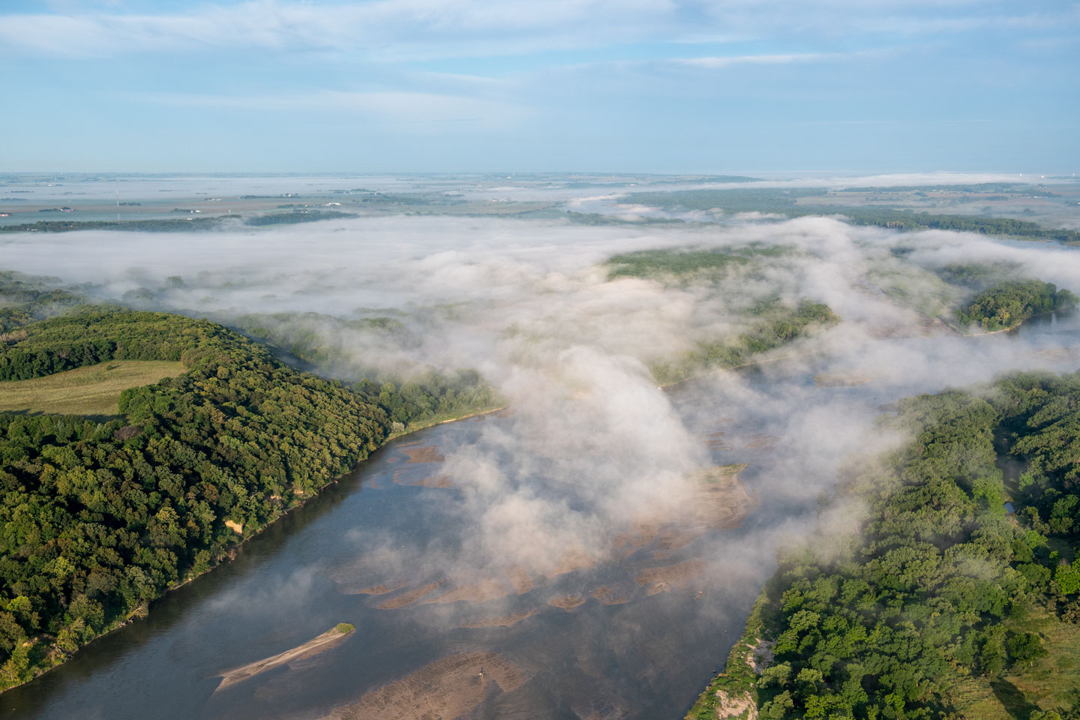
Notes:
The other major river in the Omaha area is the Platte, from which the state got its name. The geologically, the Platte is known for its gravel- and sand-rich alluvium which is often mined and makes superba aquifer

Slide 18
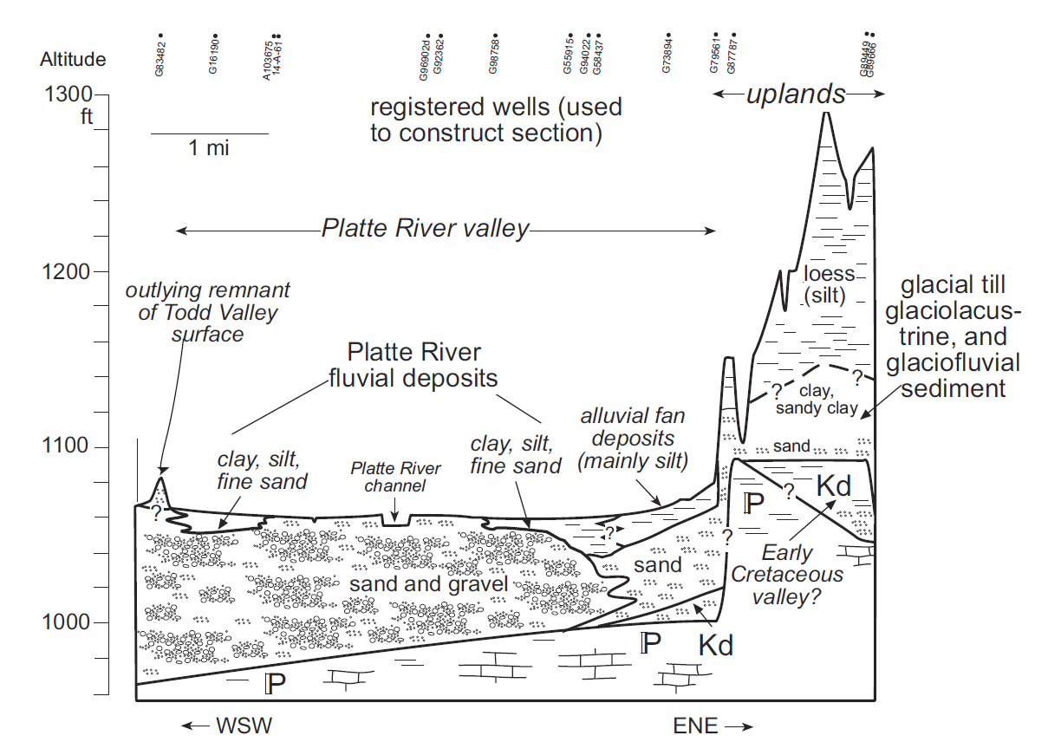

Slide 19
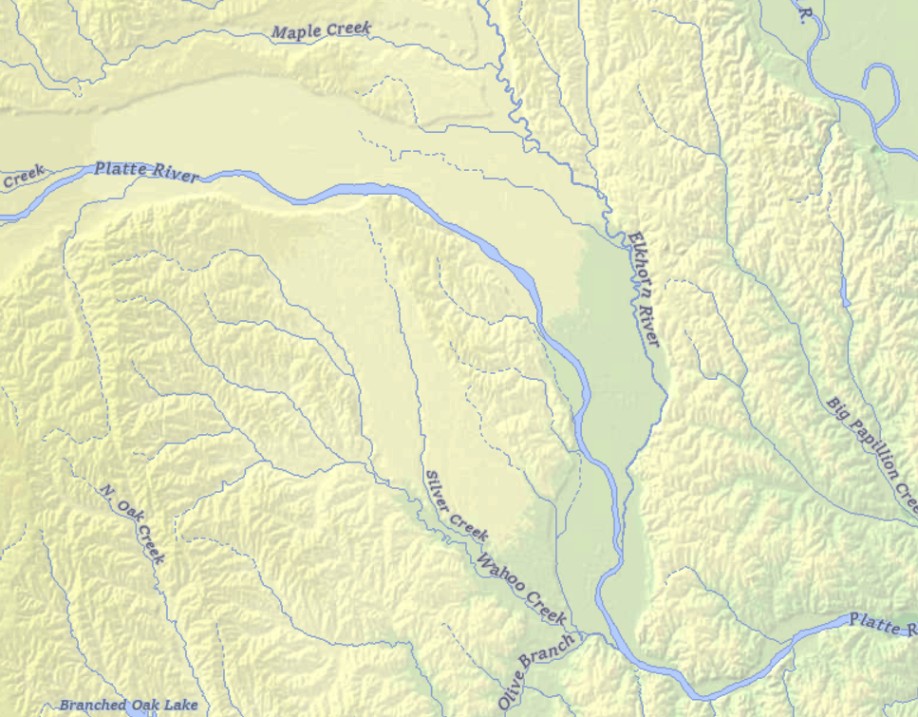
Notes:
One interesting feature of the Platte River just to the west of Omaha is Todd Valley, seen here on the elevation relief map as a localized depression. This was the original path of the Platte until the Platte switched its channel to a minor Elkhorn River tributary. The Todd Valley as a result is filled with alluvium capped with eolian sands unlike the surrounding loess hills

Slide 20
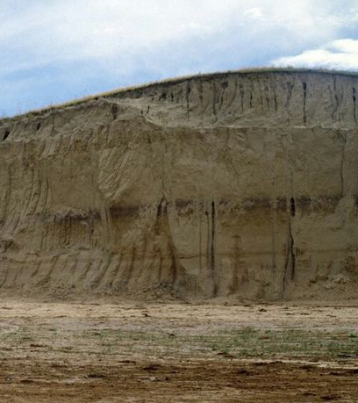
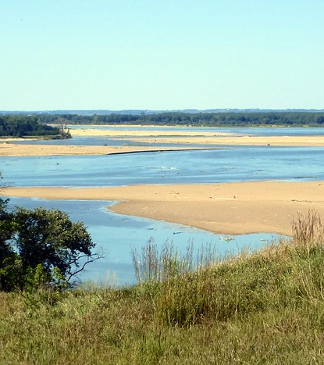
Notes:
Overall, the surficial geology of the Omaha area is defined by its Quaternary glacial history and the more recent impact of fluvial erosion and deposition. Both of these processes have important impacts on local soil formation and landscapes and make eastern Nebraska unique.

